Slide 1
Where AI-Powered Applications Are Heading
(2025 → 2028)
DSC 360 Building AI-Powered Applications
Unit 9: Course Conclusion: AI in Context

Slide 2
Calendar
Conclude conceptual part of course today
Paper Test 2 – Wednesday
Final Project – Until the end of the semester

Slide 3
Announcements
Paper Test 2 Wednesday
  Review Guide, Essay Questions on Moodle
Final Project
  Check-In 1: SMART Milestones (deadline extended to midnight)
  Check-In 2: Progress vs. Plan (due Friday)
  Detailed Rubric/other links on Moodle
    Real, working LLM application, not just vibes
    To earn score >30: Working LLM-based app
    Equivalent to a full letter grade in the course

Slide 4


Slide 5
The Plan
“Where have we been? Where are we (or where is AI) going?”
Reflect on what we learned this term
Where AI apps are going (Fall 2025 → Winter/Spring 2028)
Will this course still matter in a few years … and why?
Notes:
Last day: not a firehose of new content I want to zoom out: what did we actually do this term, where does this fit into the bigger AI story, and what might this look like if I teach this again in 2028.

Slide 6
What We Learned this Semester
Neural nets, embeddings, transformers, context windows
Semantic search with embeddings and similarity measures
RAG pipelines: retrieve, ground, generate, evaluate
Smarter retrieval: HyDE, Doc2Query, hybrid search
Structured extraction: JSON schemas, tables, Exact Match
Safe NL→SQL: roles, validators, injection guardrails
Agents as plan–act–check loops over tools
Deployment choices: local, hosted, hybrid; cost vs safety

Slide 7
What We Really Learned
Thinking in systems, not one-off demos
Handling messy data and live APIs
Turning vague ideas into experiments
Building and debugging LLM workflows
Using retrieval and evidence responsibly
Adding guardrails for safety and reliability
Explaining these systems clearly to others

Slide 8
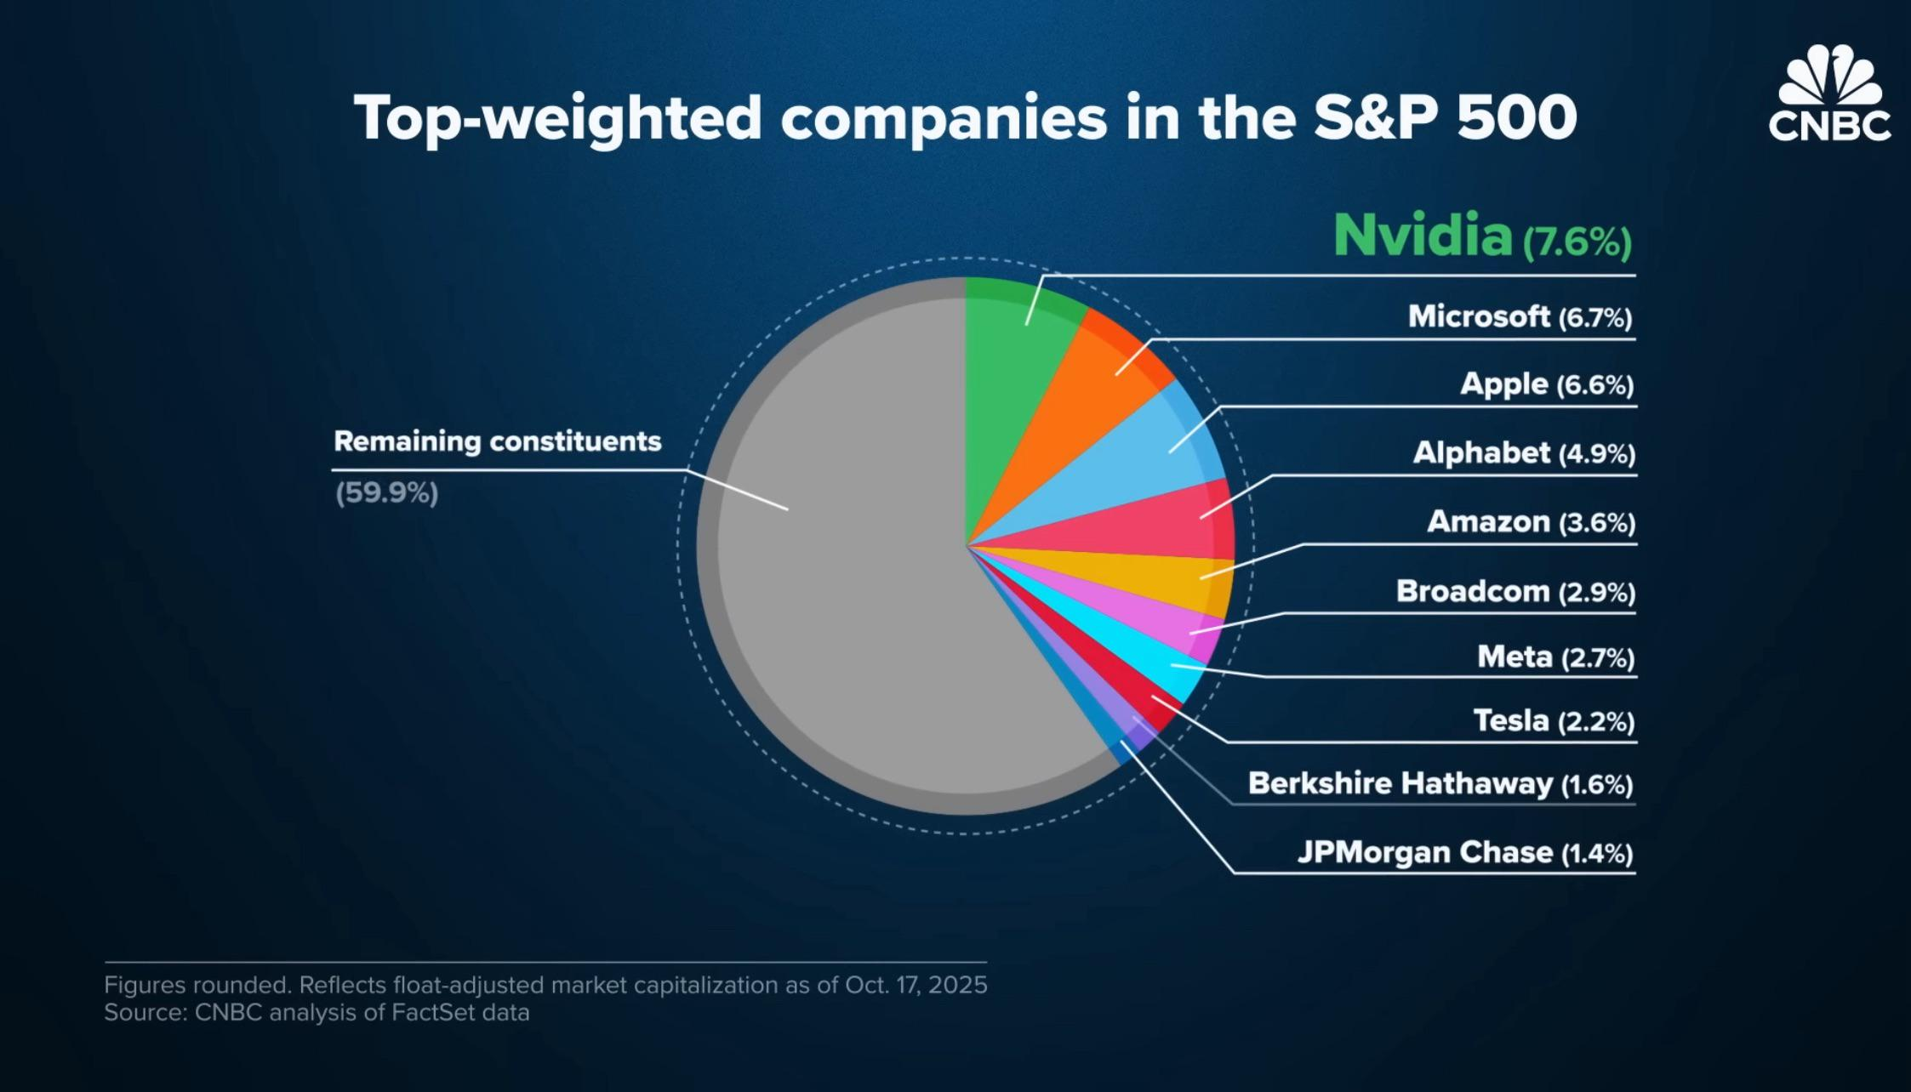

Slide 9
Why AI Apps Matter Right Now
Big chunk of market cap is tied to AI expectations
Companies rushing to ship copilots and AI features
Everyone has models; fewer people can build reliable systems
Your edge: thinking in terms of pipelines, retrieval, and evaluation
Notes:
“AI is eating the stock market” (not a finance class lol): enormous capital invested → there will be demand for people who know how to wire models into data and workflows, even if hype cools.

Slide 10
Where AI Apps Are Heading (2025 → 2028)
Retrieval-first, data-centric architectures
Agentic AI and orchestration layers
LLMOps and self-healing pipelines
SLMs and SMMs: smaller / open / on-device models
What is old is new again (e.g., planning, formal verification)
Notes:
Educated bets, not prophecies!
LLMOps are the practices, tools, and workflows for deploying, monitoring, and safely operating LLM-powered systems in production, covering everything from data pipelines and model selection to guardrails, evaluation, cost control, and continuous improvement.

Slide 11
1. Retrieval-First, Data-Centric Systems
From giant models → better retrieval
Indexes, metadata, schemas, permissions = core infra (-structure)
RAG becomes the query layer for org data
For accuracy: Data quality > model size
Advantage shifts toward data engineering and governance

Slide 12
2. Agentic AI and Orchestration Levels
“Agents” shifting from hype → practical workflow components
Multi-agent setups under the hood; users see simple features
Orchestration layers coordinate tools, retrieval, and models
2023: “AutoGPT will do my job”
2026: Task-specific agents (“invoice-matching,” “triage,” etc.)
Notes:
Practical = boring!
You already built small agents: systems that
take a user request,
retrieve info,
choose tools,
and enforce safety rules.

Slide 13
3. LLMOps and Self-Healing Pipelines
Tooling for prompt tracing, cost, and failures (observability)
Continuous evaluation + regression tests for prompts/RAG
Pipelines that detect drift or odd outputs and adapt
Early steps toward self-healing systems that diagnose + patch
Notes:
Think of an LLM “agent” watching logs, noticing “answers got worse last week,” and automatically:
updating retrieval config, or
rolling back a bad prompt, or
flagging issues for a human.
Any time you worried about jailbreaks, off-topic responses, or evaluation: that’s the seed of LLMOps.

Slide 14
4. Small, Open, and On-Device Models
Rise of Small Language Models (SLMs) for many tasks
Trade-off: smaller, cheaper, faster, often “good enough”
On-device / on-prem for privacy and low latency
Future: most systems use a mix of large + small models
Notes:
You already thought about:
context windows,
cost per 1K tokens,
local versus hosted models.
That mindset is what choosing between big vs small models will look like in practice.

Slide 15
5. Old Ideas Make a Comeback
Neural nets nearly died out twice.
Ideas return when tech catches up
LLMs excel at language, not at planning or logic
Hybrid systems: models propose, planners/verifiers check
Formal methods revived for LLM-generated code + critical tasks
Notes:
“All this has happened before, all this will happen again.”
A lot of ‘classical AI’—search, planning, logic—will sit underneath LLM-based interfaces.
This is why thinking clearly about state, actions, constraints still matters.

Slide 16
DSC 360 in 2028: What Might Be Different?
More multi-agent workflows and orchestration by default
Greater emphasis on evaluation, logging, and LLMOps
More small/open models running locally
Less “What is RAG?” → more advanced retrieval methods
More formal checks for safety and correctness

Slide 17
What You Can Honestly Claim You Know How to Do
Built an LLM-powered application end-to-end
Worked with APIs, JSON, and config, not just chat UIs
Designed prompts and retrieval pipelines for real tasks
Considered safety, failure modes, and evaluation
Delivered a project with moving parts and real constraints

Slide 18
Final Thoughts
Concepts last; APIs don’t
Retrieval, evaluation, safety remain core
Your “slog” shows you can manage complex systems
Stay curious, skeptical, and experimental

